Slide 1


Intent
Classification
Group Members:
Rutik Pol

Slide 2
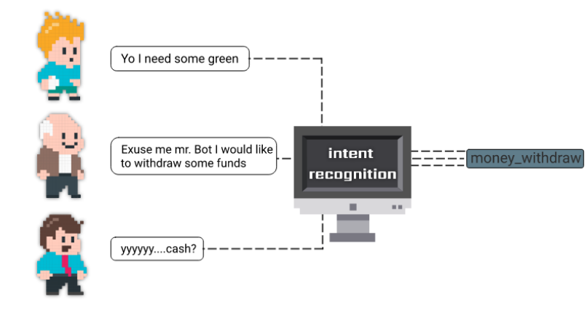

Slide 3

Aim, Objective & Algorithm
AIM:
Construct a language model that “UNDERSTANDS THE CONTEXT” of a sentence
Performs Named Entity Recognition
Performs POS Tagging
Combines all this data and makes API calls
Is highly available, redundant and fast
ALGORITHM: Transformer, an attention mechanism that learns contextual relations between words (or sub-words) in a text. In its vanilla form, Transformer includes two separate mechanisms — an encoder that reads the text input and a decoder that produces a prediction for the task. Since BERT’s goal is to generate a language model, only the encoder mechanism is necessary.

Slide 4

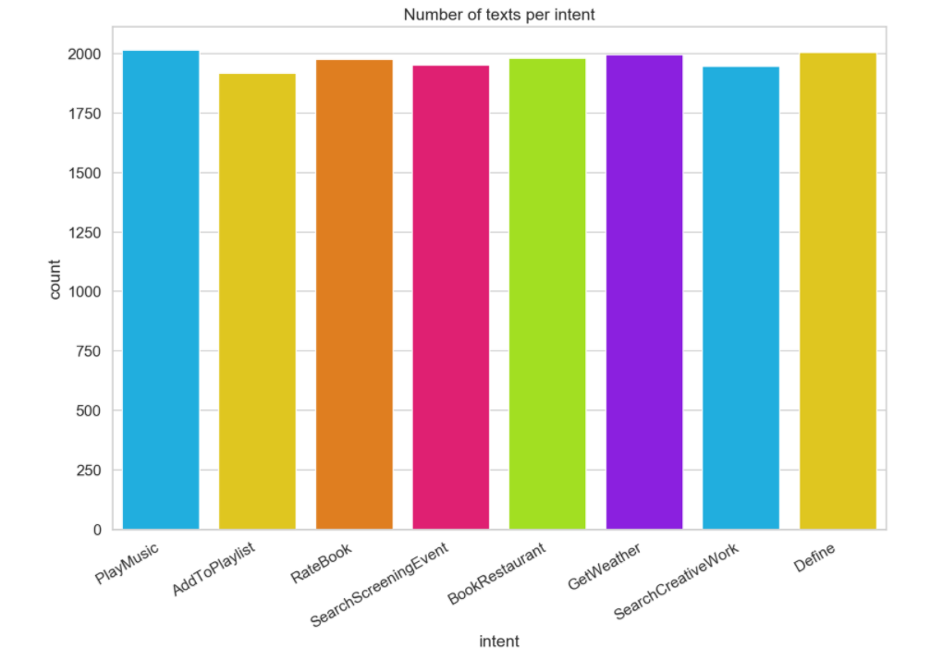
Dataset
Self generated Dataset “Search ",
"Tell me about ",
“What is ",
“Any idea on ",
“Spain”,
“Car”,
“AI”,
“Ferrari”

Slide 5
Basic Algorithm
Tokenize, Lemmatize and convert words to numbers
Generate Attention Vectors & Word Embeddings using BERT
Pass embeddings to DNN for classification
Perform NER & POS Tagging
Make API Calls

Slide 6

Feature Vector
Sentence in Dataset : What do you know about Michael Schumacher?
After Tokenisation: ['what', 'do', 'you', 'know', 'about', 'michael', 'schumacher’, ‘?’]
Tokens to TokenID : [2054, 2079, 2017, 2113, 2055, 2745, 22253, 1029]

Slide 7
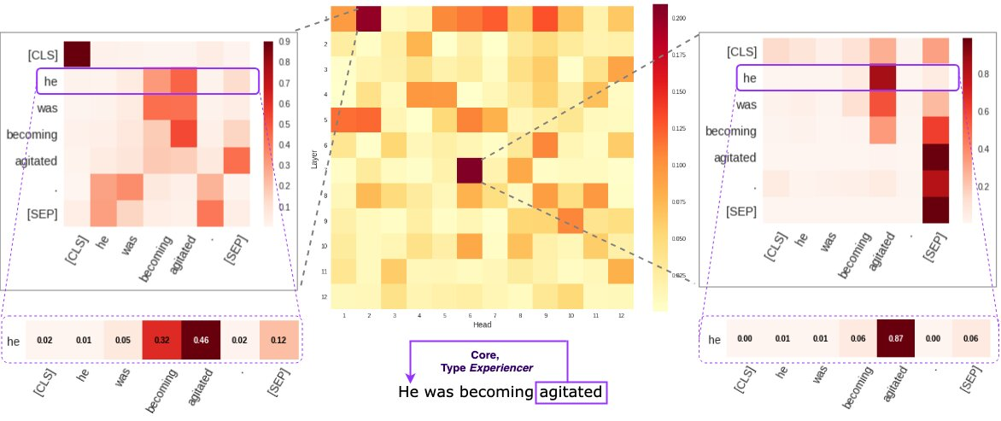
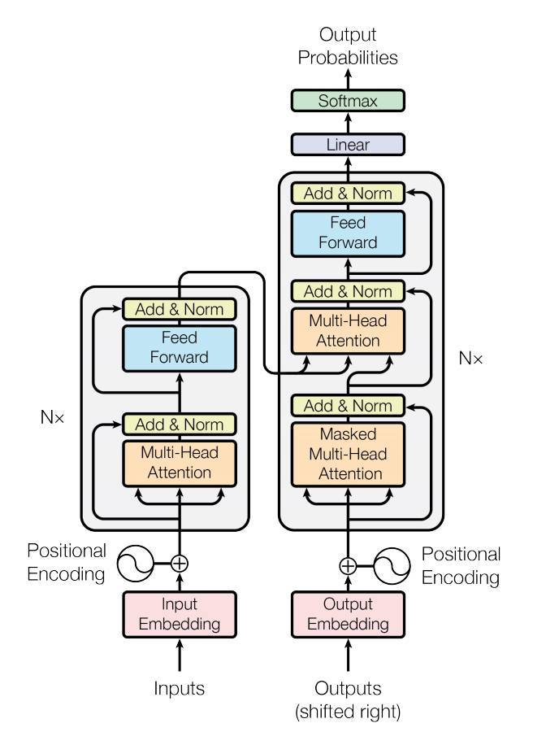
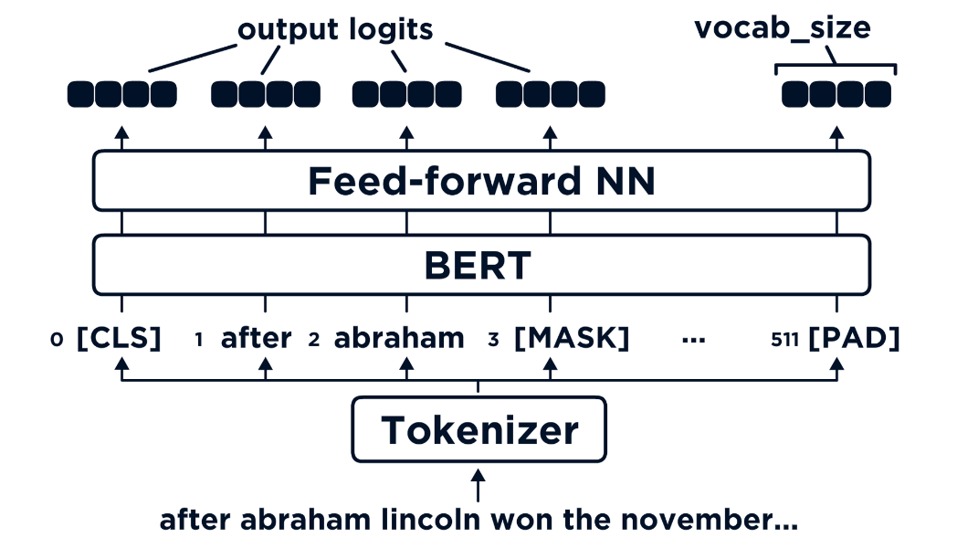

Slide 8
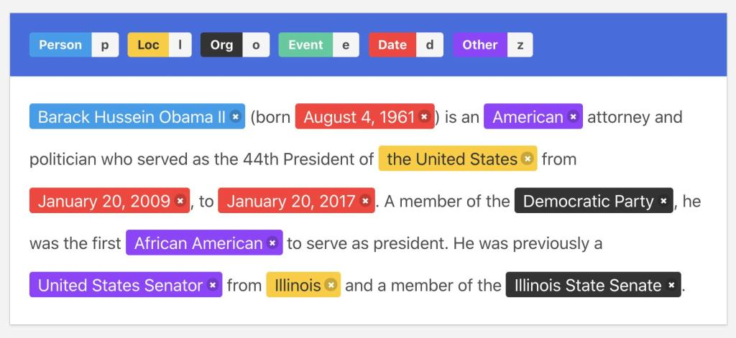
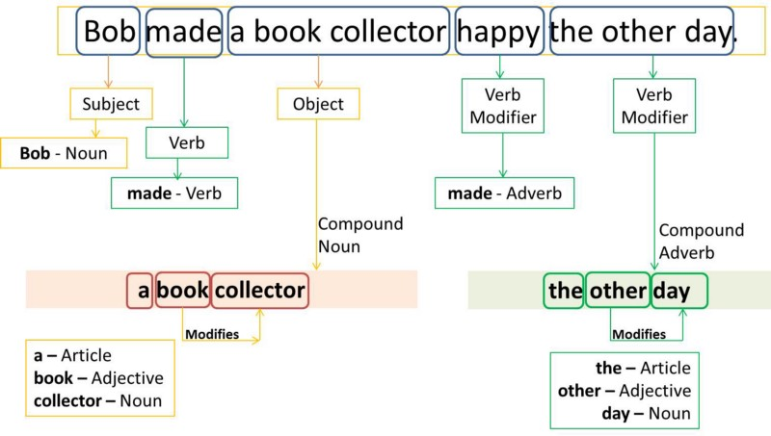
Named Entity
Recognition
Part of Speech
Tagging

Slide 9
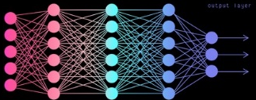
Tell me about Ferrari
POS Tagging
Proper Noun
Define
Ferrari
Display Top 3
Google Search
Results about Ferrari
Query Wikipedia
API about next
best result
Query Wikipedia
API about Ferrari

Slide 10
Is it cold in Moscow
Named Entity
Recognition
Geographical
Location
Weather
Moscow
Scrape API response
for temperature, humidity
& wind speed
Query Weather
API about Moscow’s
Weather
Log Errors

Slide 11
Play Levitating
POS Tagging
Noun/Verb
Play Music
Levitating
Display URL or
Log Error
Scrape API results
for song’s URL
Query YouTube
API about Levitating

Slide 12
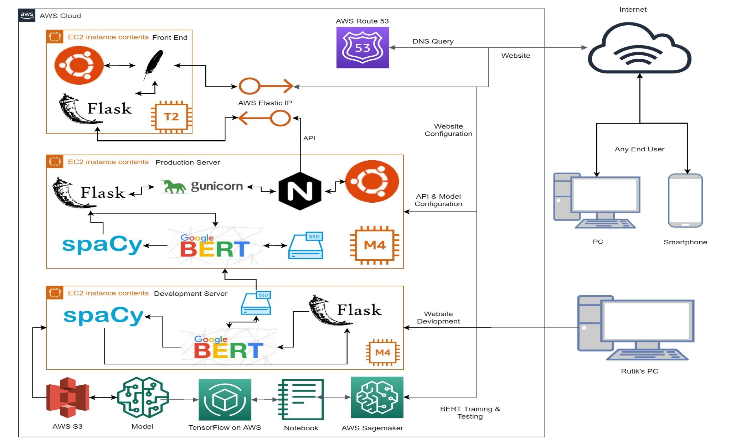

Slide 13
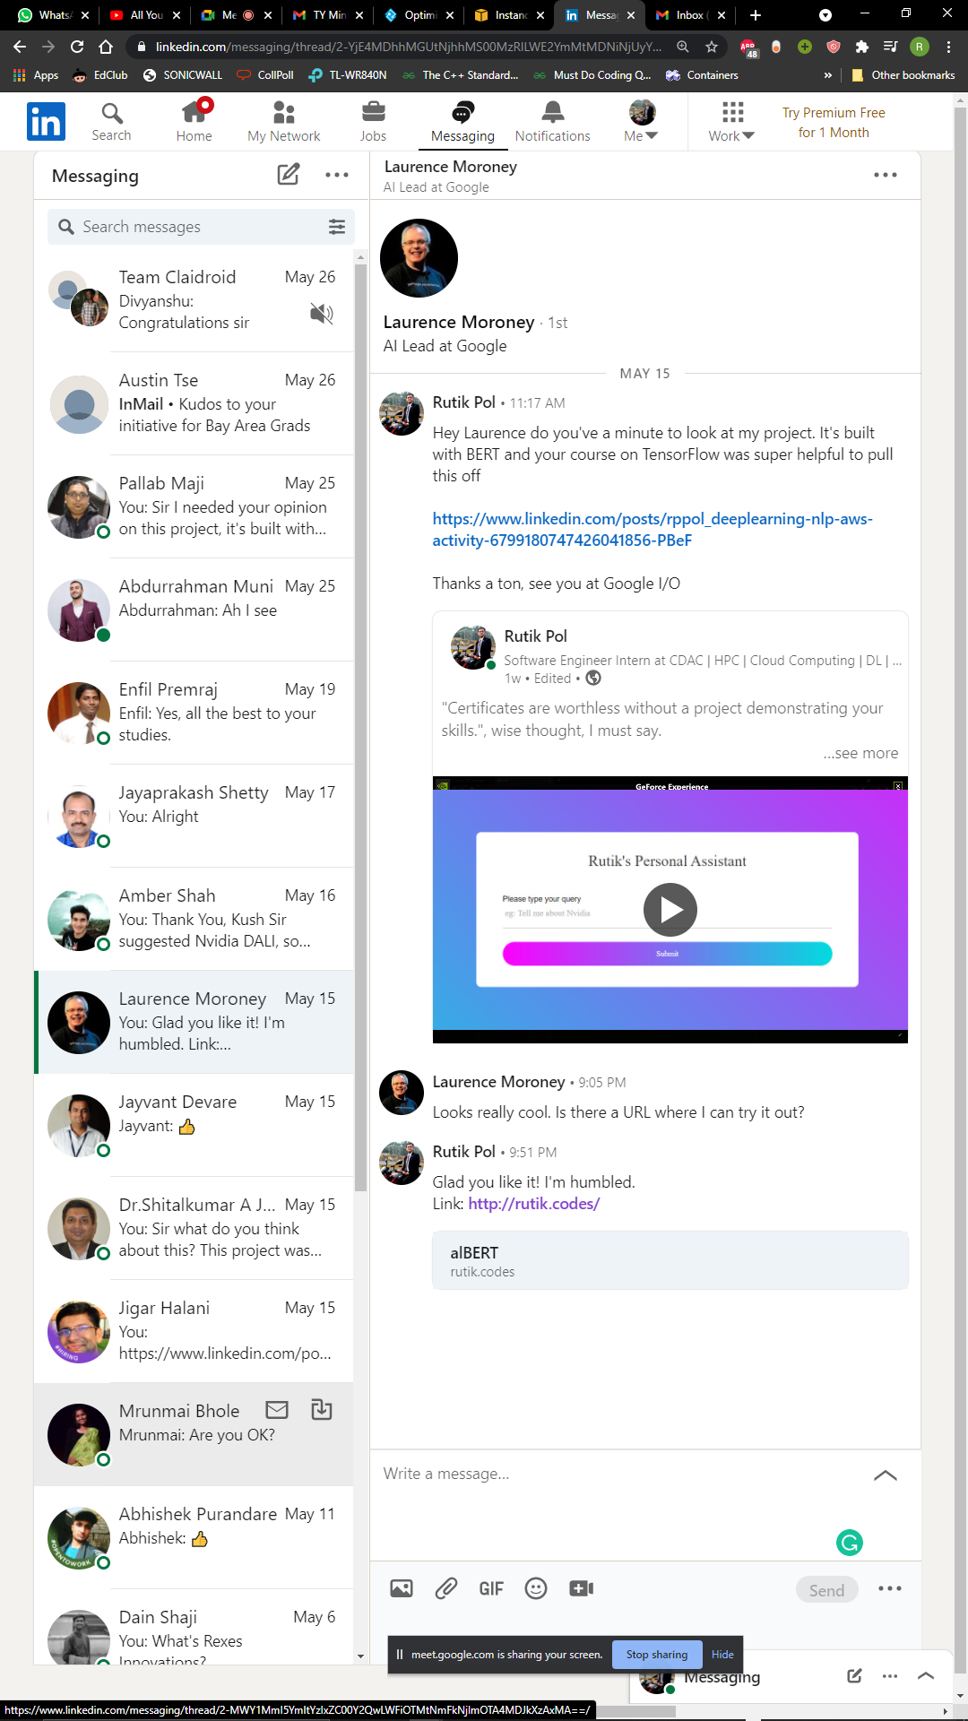
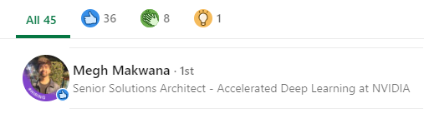
Liked by :
AI Lead at Google
Senior Deep Learning Architect at Nvidia

Slide 14
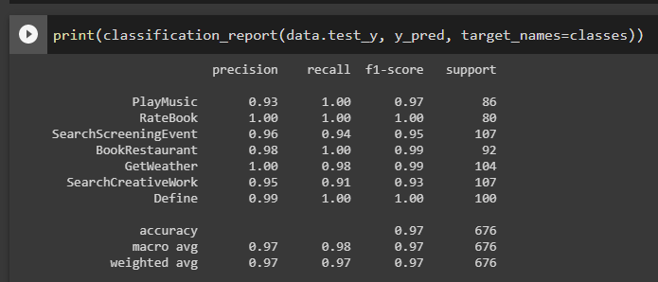
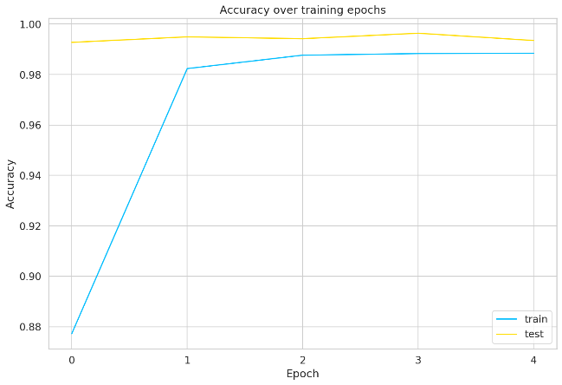
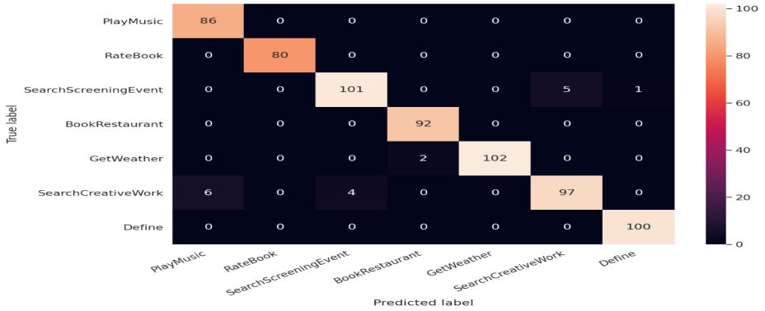
Results & Analysis (Graph visualization)
www.rutik.codes

Slide 15
References
Understanding; Devlin et al., 2018.
The Annotated Transformer; Alexander Rush, Vincent Nguyen and Guillaume Klein.
Universal Language Model Fine-tuning for Text Classification; Howard et al., 2018.
Improving Language Understanding by Generative Pre-Training; Radford et al., 2018.
Attention Is All You Need; Vaswani et al., 2017.
BERT: Pre-training of Deep Bidirectional Transformers for Language

Slide 16


